Slide 1
GIS Committee Meeting 5/22/2019

Slide 2
WIFI Information Network: User name: Password:

Slide 3
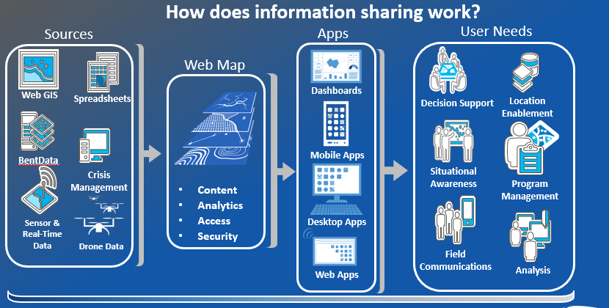
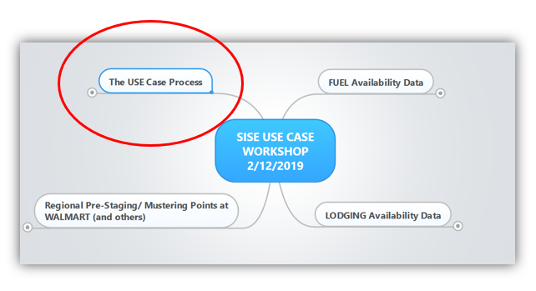
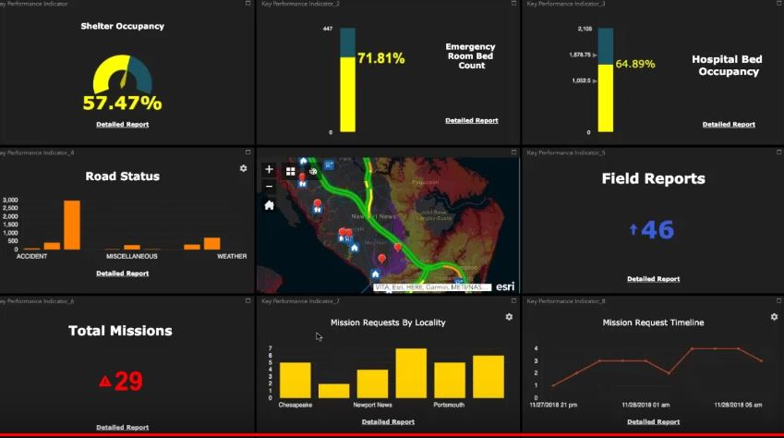
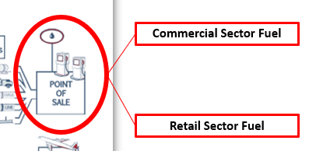
SISE GIS /ORL Committee Meeting
Better More Organized Data…Faster Decision Making
May 2019

Slide 4
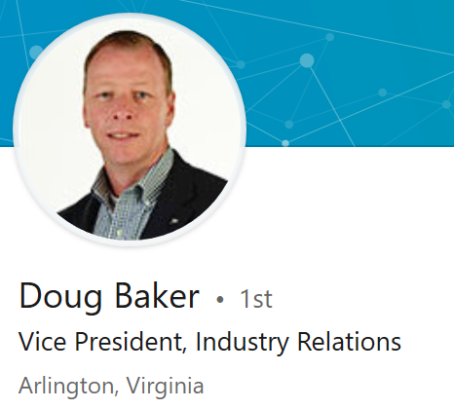
Opening Remarks & Welcome to Food Marketing Institute
Linkedin: https://www.linkedin.com/in/debaker/

Slide 5
Opening Remarks
Chair, SISE GIS Committee
LinkedIn: https://www.linkedin.com/in/kari-hicks-82360029/

Slide 6
Agenda – May 22 Wednesday
Time | Description
1:00pm | Welcome & Opening Remarks
1:15pm | Session #1 – Progress Report Description: This session will a discussion on the progress of the GIS/ORL Committee of the SISE and onboarding of participants into the meeting facilitation tools
2:00pm | Session #2 – Use Case Discussion – Damage Assessment Description: This session will focus on a discussion on a Use Case being developed for “damage assessment”. Focused on the impacts of the recent Hurricane Florence as a scenario, participants will walk through the SISE’s Use Case Development process and work towards short, mid and long-term solutions. Topics to include defining problem; cross sector impacts; possible government/industry data providers, data users and datasets; data sensitivity issues; and possible solutions
3:00pm | Session #3 – GIS/ORL Committee Decision Tools and Work Products Description: The session will focus on the work products produced and the technical solutions/dashboards being tested for both decision makers and GIS technical personnel. Will include discussions on the ORL standard, current “ORL1” dataset library, dashboards and strategy for educating decision makers and technicians on the importance of this effort.
4:00pm | Conclusion

Slide 7
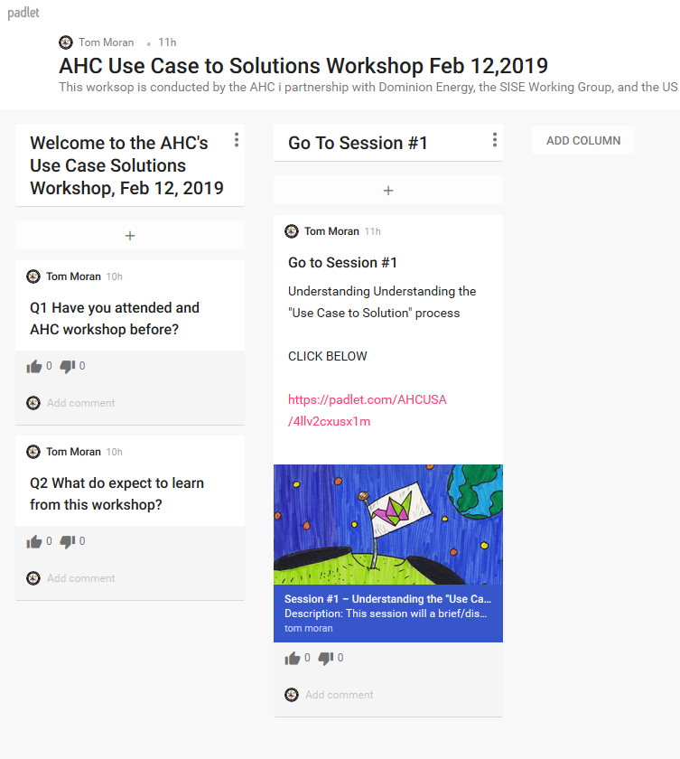
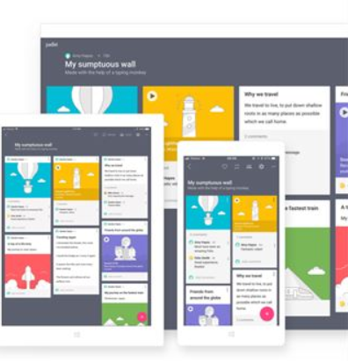
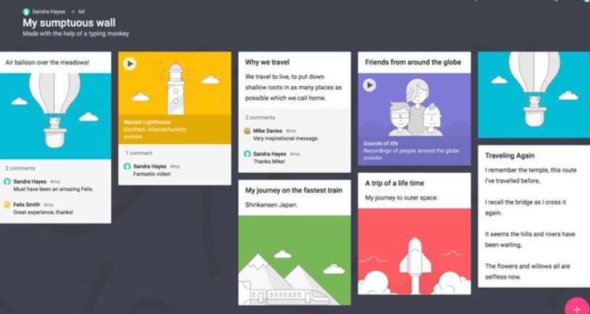
SISE Facilitation Tools
Virtual Meeting App - PADLET

Slide 8
Virtual Collaboration Technology Drill

Slide 9
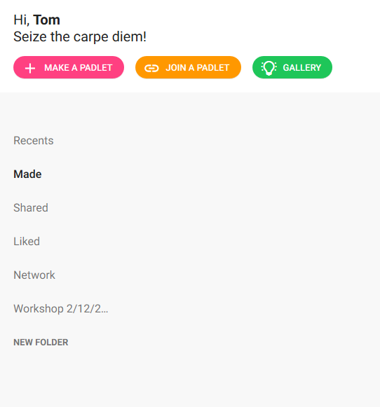
Virtual Meeting Drill Padlet App for Collaborative Meetings & Note Taking
Will conduct training NOW drill to onboard SISE WG to meeting collaboration tool to be use in 2019
STEP 1
Go to www.padlet.com and create FREE account
STEP 2
Login to your FREE Padlet app account
STEP3
CLICK on “JOIN A PADLET” button
STEP 4
Copy/Paste in session link below: https://padlet.com/AHCUSA/sisegiscommmtg5_23_2019
Does NOT work with Internet Explorer

Slide 10
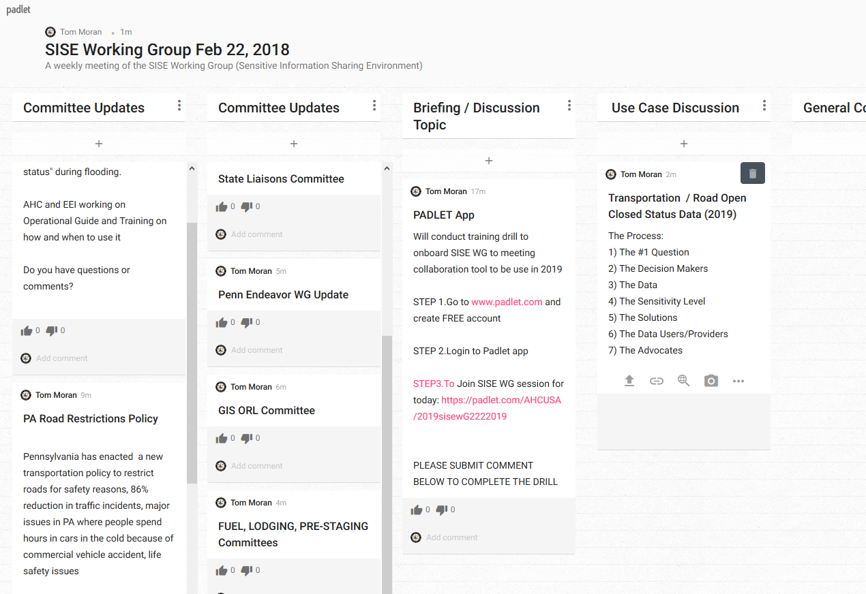
TODAY’S SISE PADLET Session
SESSION INFO & TOPICS TO DISCUSS
May 22, 2019 SISE GIS Committee Meeting
QUESTIONS OR TOPICS POSTED:
AUTHOR OF POST
ENTER YOUR FEEDBACK IN COMMENTS SECTION UNDER EACH POST

Slide 11
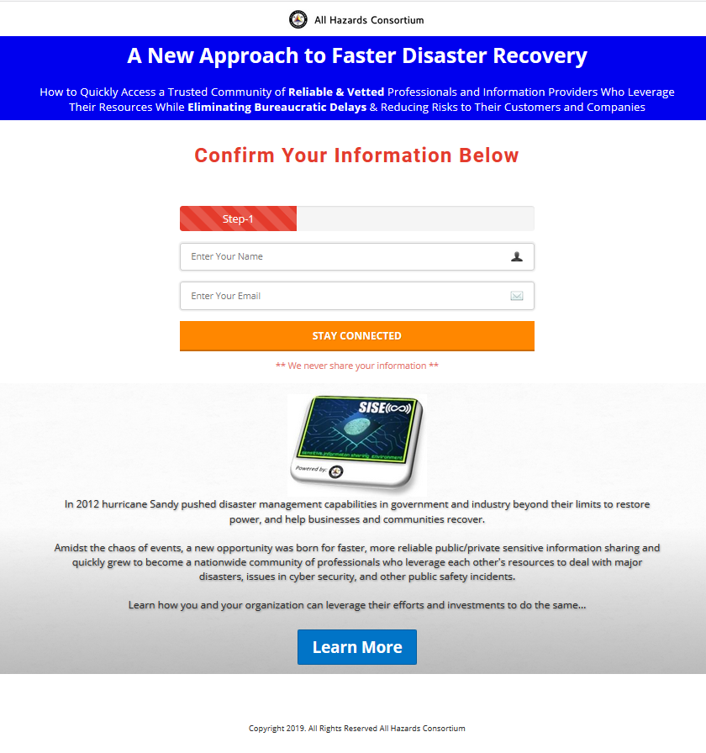
SISE Registration
Go to https://www.siseusa.org
Fill out form
You will be registered w/SISE
Future access to future information and alerts

Slide 12
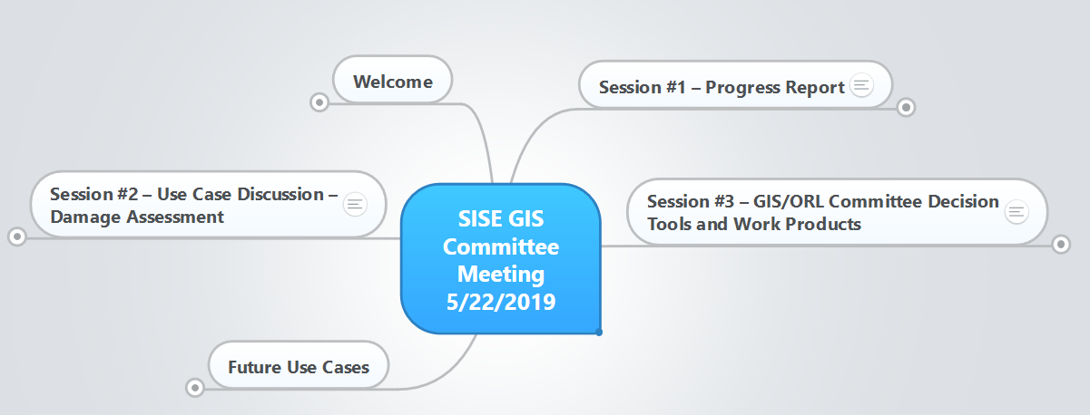
Mind Mapping Tool
Planning, education & facilitation tool
Show interdependencies & use cases
URL: https://www.mindmeister.com/1270383957?t=kRWU6cgPWF

Slide 13
Session #1 Committee Progress Report

Slide 14
The ORL Standard Vision
Food / Water
Private Sector
Transportation
Private Sector
Communications
Private Sector
Private Sector
Energy / Power / Fuel
ORL RESULTS
Federated DATA Reliability STDs….i.e. stakeholders agree to the metrics, meanings, process, labels, etc…
Reduces confusion.. Builds trust
Enhances decision maker confidence in data
Joint GIS / ORL Committee
ORLs
Federal
State DOT
State Police
State OEM
Shared Understanding…Unity of Effort….Coordinated Decisions

Slide 15
The SISE GIS/ORL Committee
Food / Water
Private Sector
Transportation
Private Sector
Communications
Private Sector
Private Sector
Energy / Power / Fuel
Facilitated public/private work group
Developing federated standard (rev 2)
Operational testing
Education & outreach
Executive Dashboards, Toolkits & Datasets
GIS / ORL Committee
Federal
State DOT
State Police
State OEM

Slide 16
Committee Results to Date
Policy
Standards Development
ORLs- Finalize and Agree on ORL Standard (Rev2.0) (COMPLETE)
ORL 1 Dashboards
Create ORL 1 dashboard (IN PROCESS)
Liability
Agree to AHC’s liability statement (COMPLETE)
Education
Design materials for Exec, Ops Mgrs and GIS professionals (IN PROCESS)
Produce webinar (IN PROCESS)
Live Workshop
Plan live mtg/event in 2019 – May 22, 2019 (IN PROCESS)
ORL Web Tool Kit
Set of tools to educate, use dashboard, jump start operationalizing ORLs (IN PROCESS)
Executive Webinar series
Pilot Project
TTX, Roundtables, or Test during events, Webinar TTX
Secure ORL Chat/Help Desk during storms w/SISE
Use Cases
Damage Assessment (IN PROCESS)

Slide 17
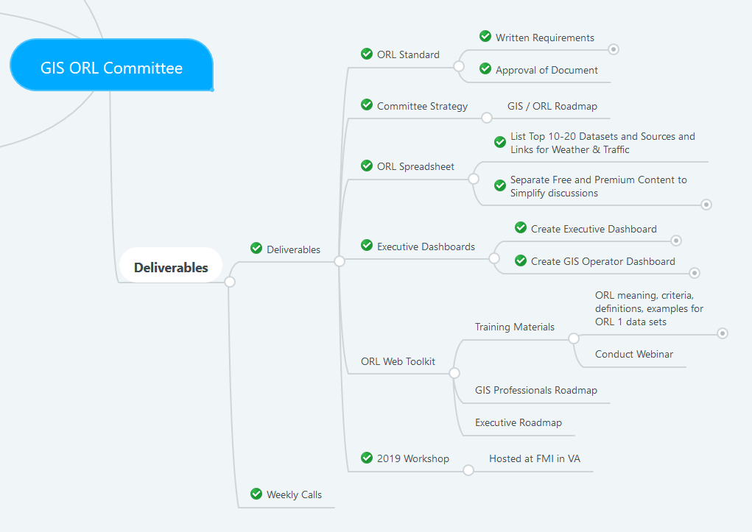
2019 Deliverables

Slide 18
ORL Standard At-a-Glance Operational Readiness Levels (Focusing on Reliability & Trusted Sources of Data)
Comments & input from group (ID yourself)
ORL
Data available NOW
Immediate Situational Awareness (SA) & Decision Making (DM)
Person available to contact
4
3
2
1
OPERATIONAL READINESS LEVEL
ORL
Data available sporadically
Event-driven, may be delayed due to acquisition and processing time required
Could be very useful for SA & DM
Person available to contact
OPERATIONAL READINESS LEVEL
ORL
Data nearly operational, testing phase
Not guaranteed
Could improve SA and DM
Target operations in 6-12 months
OPERATIONAL READINESS LEVEL
ORL
Data in collection, processing and/or testing phase
Being evaluated for accuracy, validated
Target for operations 12+ months
Not likely to be immediately useful for operations
OPERATIONAL READINESS LEVEL

Slide 19
ORL Standard Specs
Re-Visit purpose of ORL – Kari

Slide 20
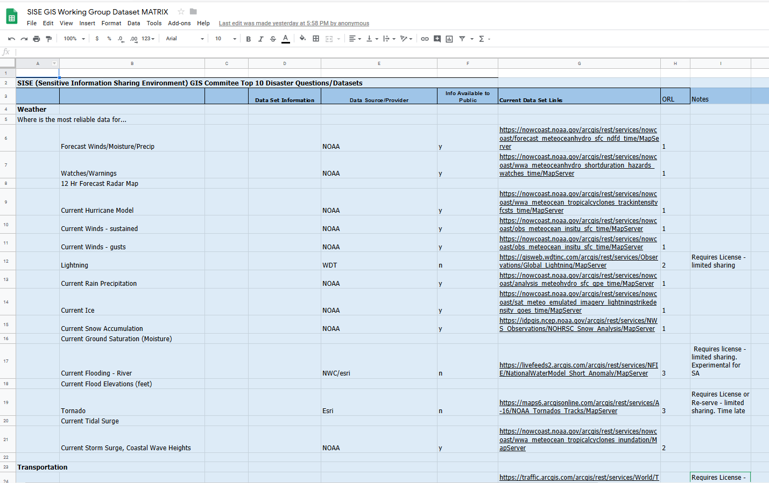
ORL1 – Top Datasets Spreadsheet

Slide 21
Strategy: ORL Use Case Roadmap

Slide 22
Strategy: ORL Use Case Roadmap
GIS Professionals
Decision Makers

Slide 23
Strategy: ORL Use Case Roadmap
Develop Multiple Use Cases
ORL Data Reliability Ranking STD

Slide 24
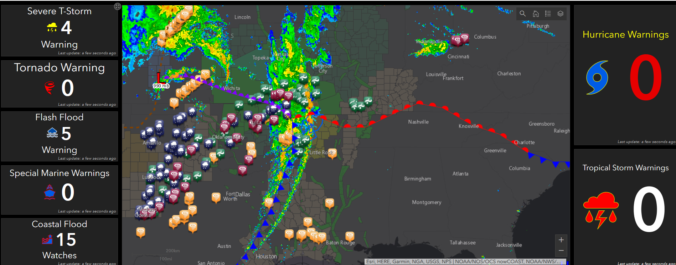
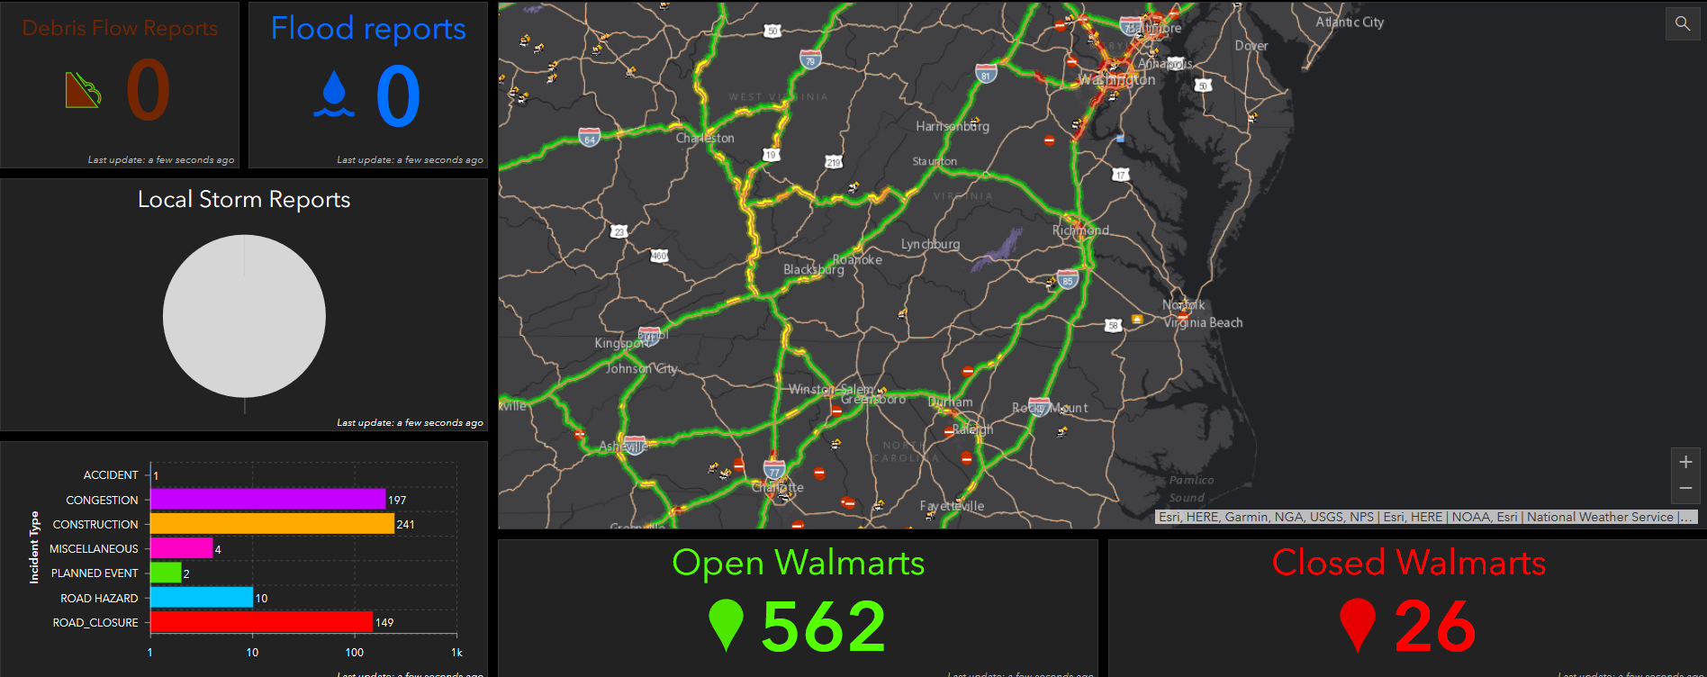
Executive “ORL1” Dashboards w/Most reliable data sources, organized for 30sec Decisions
Executive “Decision Making” Dashboards
Most reliable data
Better organized
Always on
30 second decisions
Customized per “Use Case”
Faster, simpler
Mobile enabled

Slide 25
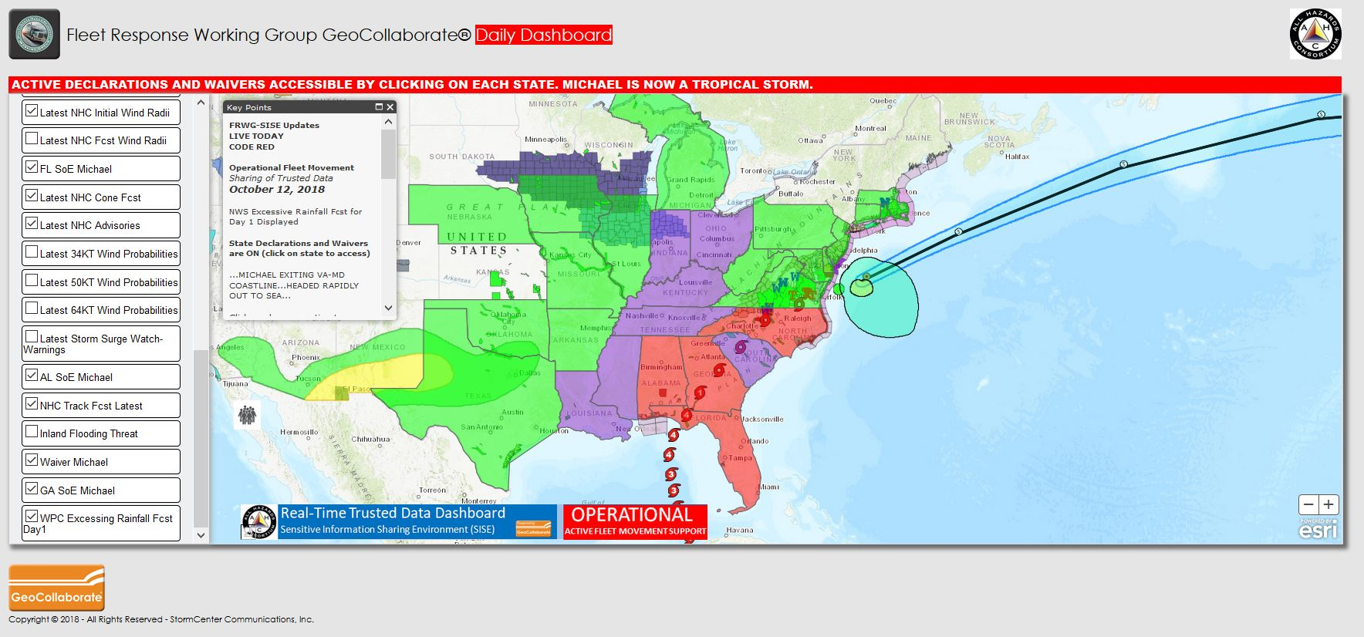
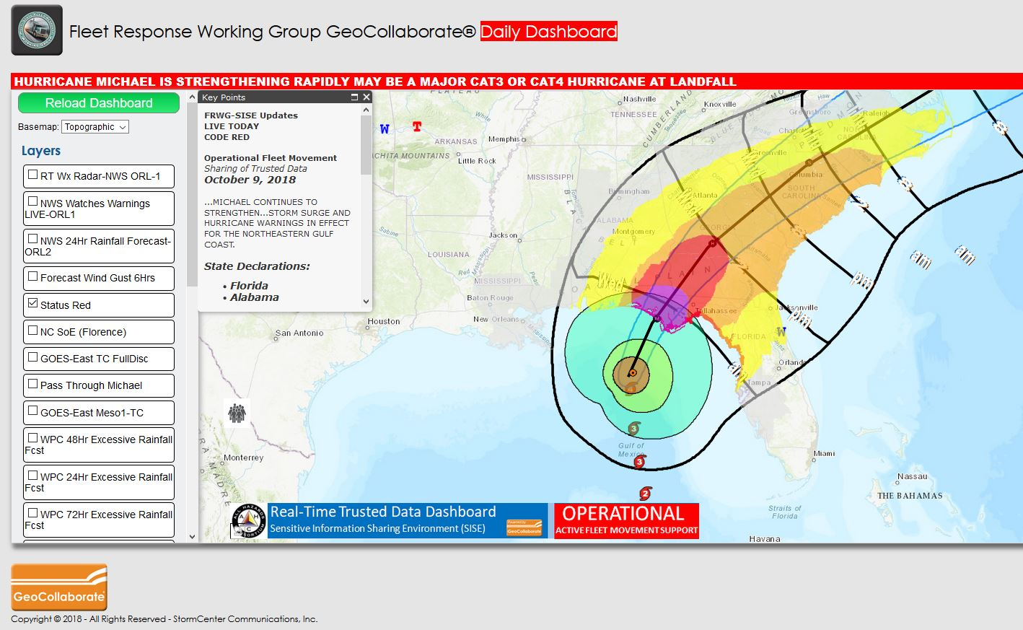
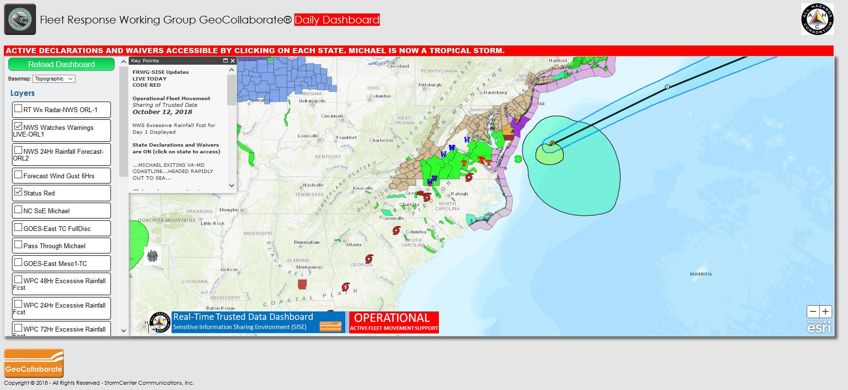
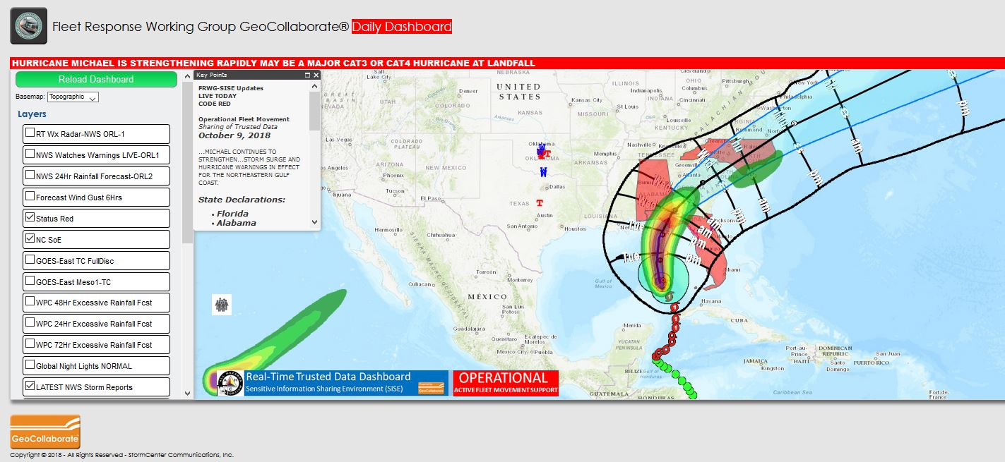
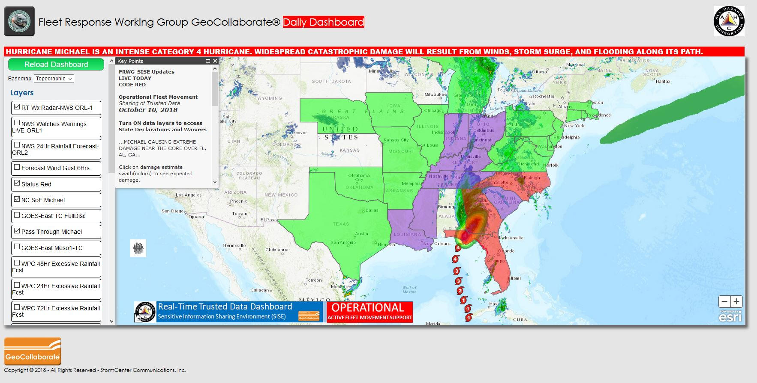
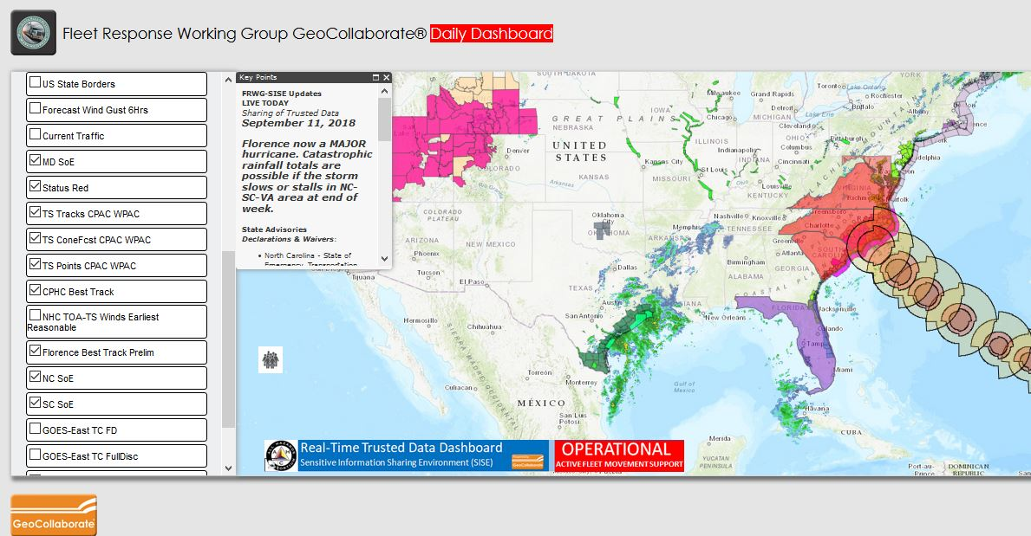
Operational Use Case Dashboards w/Secure Data Collaboration Between SISE members
For Operational Coordination w/Multiple States & Sector for Power Restoration
Real-time data
Combines gov’t & industry data
Reduces inter-state movement delays
Operations since 2016

Slide 26
ORL Storyboard
LinkedIn: https://www.linkedin.com/in/kari-hicks-82360029/

Slide 27
Session #2 Use Case Discussion “Damage Assessment”

Slide 28
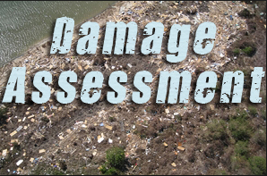
The #1 Thing
Many problems to solve…
Organization to engage…
What’s the #1 question to answer?

Slide 29
The #1 Question to Answer
What are private sector decision maker’s #1 QUESTION they need answered on this topic during a regional disaster?
How do I find out the extent of the damage to the impacted areas and infrastructure faster?
S2Q1

Slide 30
What’s SISE’s Use Case Process?
Implement & Enhance Solutions
Explore & Test Possibilities for Solutions
Work The Use Case Process via Committees
Identify, Define & Prioritize the Problem
Timeline

Slide 31
Use Case Development Template
The Problem:
The Impacts:
The Decision Makers / People to Engage:
The Datasets & Data Sources (Owners):
The Data Sensitivity Needed:
Possible Solutions:
Short-term
Mid-term
Long-term
The Data Users & Facilitators:

Slide 32
Problem Statement
During regional, multi-state disasters, transportation power distribution and communications infrastructure is damaged to varying degrees.
Private sector’s response and restoration efforts are delayed due to not knowing the extent of the damage to these infrastructures at the state/local levels.
Access to reliable, more organized damage assessment data “faster” is vital to restoration efforts in government and industry.
S2Q3

Slide 33
Impact Statement
When a community’s critical infrastructure is disrupted, transportation routes close, power is out, communications are down, fuel is scarce and supply lines are disrupted.
Lives are at risk, and communities and businesses go dark causing economies to stop.
Industry and government must coordinate many time to reduce overall risk and promote recovery.
S2Q3

Slide 34
Decision Makers/People to Engage
Government?
Industry?
Other?
S2Q3

Slide 35
Datasets & Data Sources (Owners)
Government?
Industry?
Other?
S2Q3

Slide 36
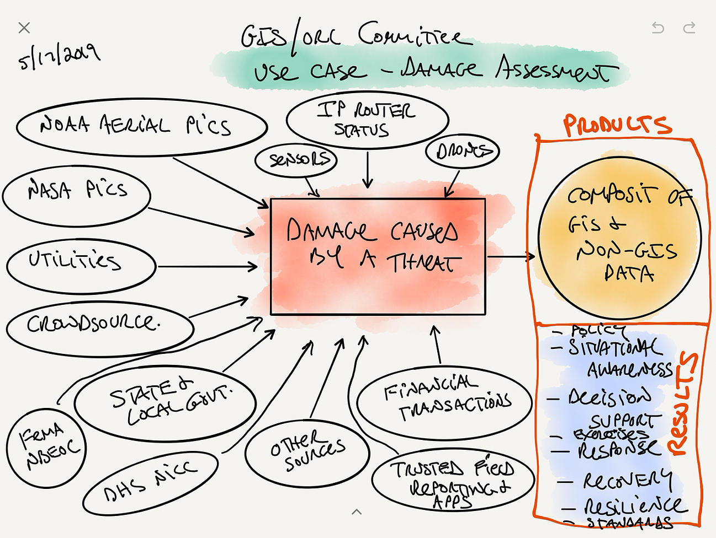
Datasets & Sources for Damage Assessments

Slide 37
Datasets & Data Sources (Owners)
Origin of Data
Consumption of Data
FACILITATORS
USERS
DATASETS
DATA
OWNERS
Data Sensors, Monitoring Systems or Equipment
Owners of Sensors, Systems, Connections, IP Addresses or Equipment
Aggregators, Brokers & Facilitators of Data
Data Users, Consumers
S2Q5

Slide 38
Data Sensitivity Needed
How sensitive is the availability data information?
Operational Use only for this use case, competitively/legally sensitive at times
S2Q11

Slide 39
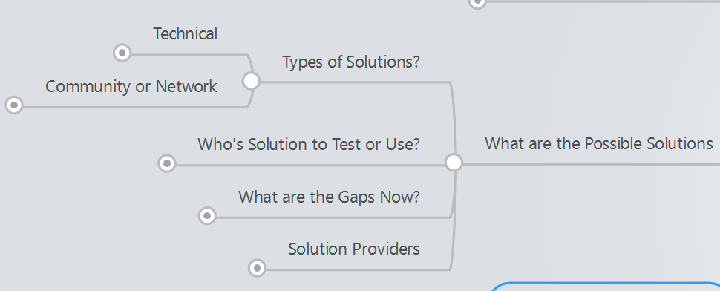
Possible Solutions
Datasets – Private sector owners & operators
Dashboards - Government, Private, Other
Apps/Websites - Gas Buddy
Communities / Network of People
Others?
S2Q12

Slide 40
Data Users & Facilitators
Who are the Data Users?
Industry?
Government?
Others?
S2Q16

Slide 41
Session #3 GIS/ORL Committee Decision Tools and Work Products

Slide 42
Tools & Products
Policies… Processes… Technologies… Community

Slide 43
ESRI ORL Storyboard
LinkedIn: https://www.linkedin.com/in/kari-hicks-82360029/

Slide 44
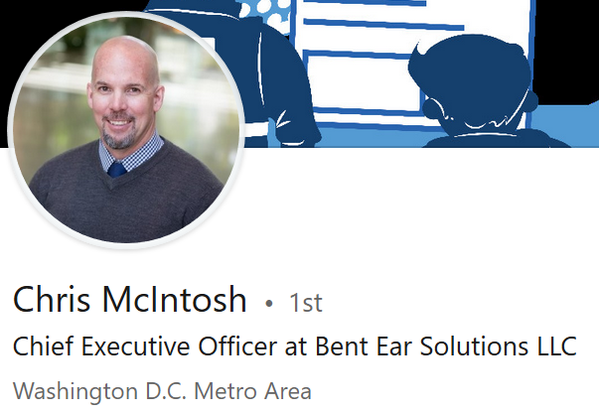
SISE Executive Dashboards
LinkedIn: https://www.linkedin.com/in/chris-mcintosh-bes/

Slide 45
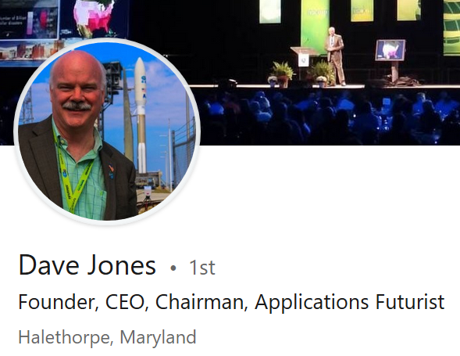
SISE Operational Dashboards
LinkedIn: https://www.linkedin.com/in/chris-mcintosh-bes/

Slide 46
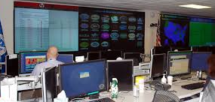
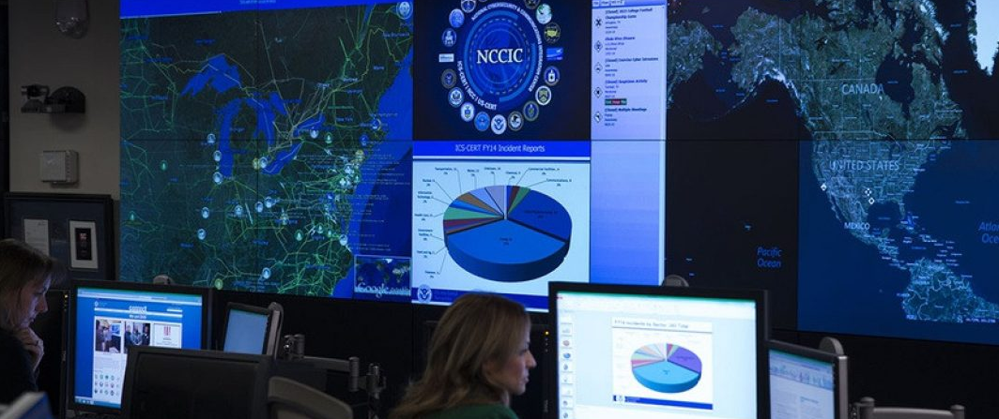
SISE / DHS NICC Information Sharing Opportunities

Slide 47
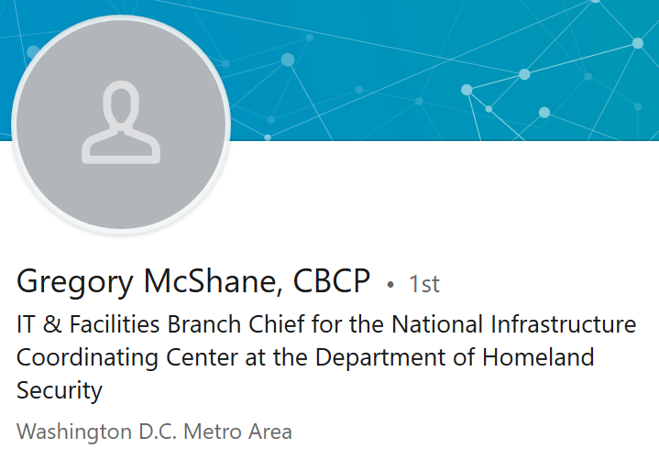
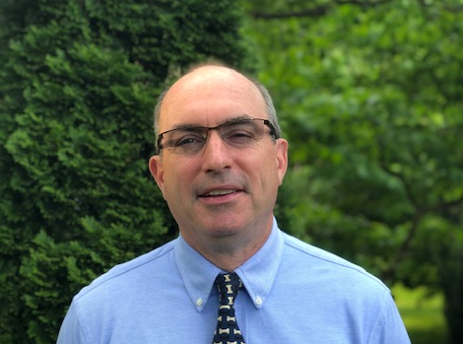
SISE / DHS Opportunities
LinkedIn: https://www.linkedin.com/in/gregory-mcshane-cbcp-6670587/

Slide 48
Conclusion

Slide 49
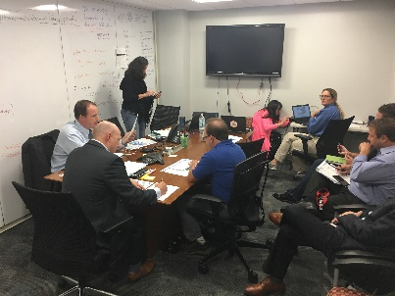
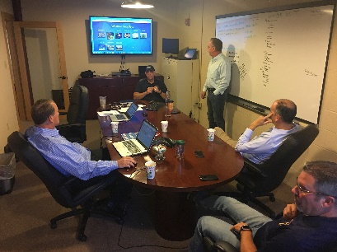
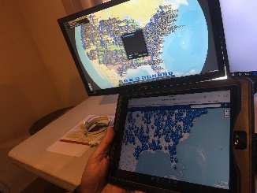
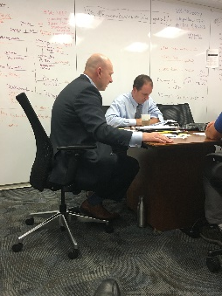
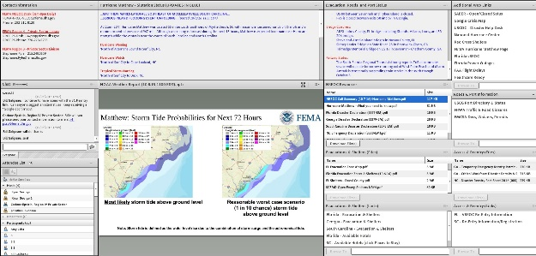
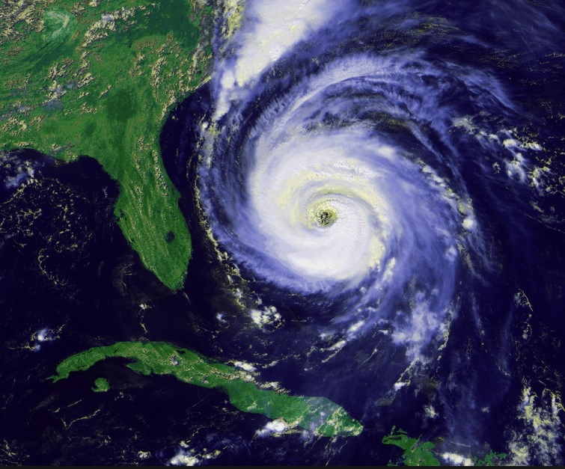
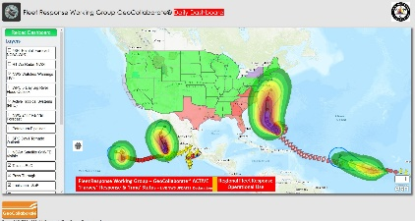
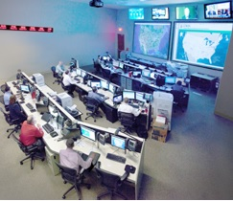
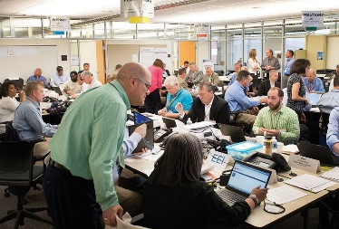
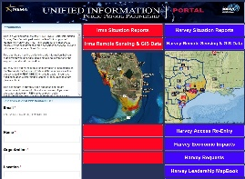
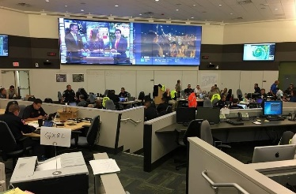
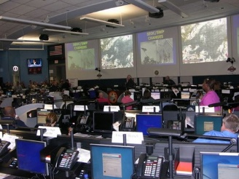
Disaster Coordination
DOD
US DOT
US DOE
NOAA
FEMA NBEOC
AHC / SISE
FEMA LOGISTICS
FLORENCE
DHS NICC
EEI Ops Center
APPA
NRECA
NEMA / IAEM Dashboards
NC EOC
SC EOC

Slide 50
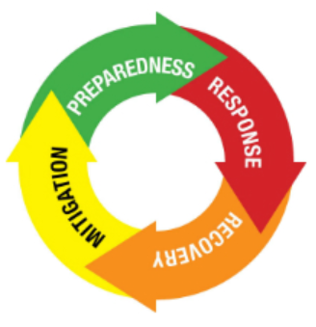
Long Term SISE Strategy
SISE Framework Using ORL Standard
Private Sector
User
State/Local EOCs
State/Local Fusion Centers & DOTs
Operational Coordination
(Multi-State and Multi-Sector Operational Coordination on Operational Delays & Work Arounds)
Federal Dashboards
(FEMA, DHS NICC, DOE, etc..)
Data Analytics, Modeling & Exercises
(Creating What If’s, Monitoring Rolling Costs of Response, Determining Cascading Impacts & Supply Chain Disruptions, Support Exercises)

Slide 51
Closing Remarks
Chair, SISE GIS Committee
LinkedIn: https://www.linkedin.com/in/kari-hicks-82360029/

Slide 52
SISE GIS /ORL Committee Meeting
Better More Organized Data…Faster Decision Making
May 2019

