Slide 1
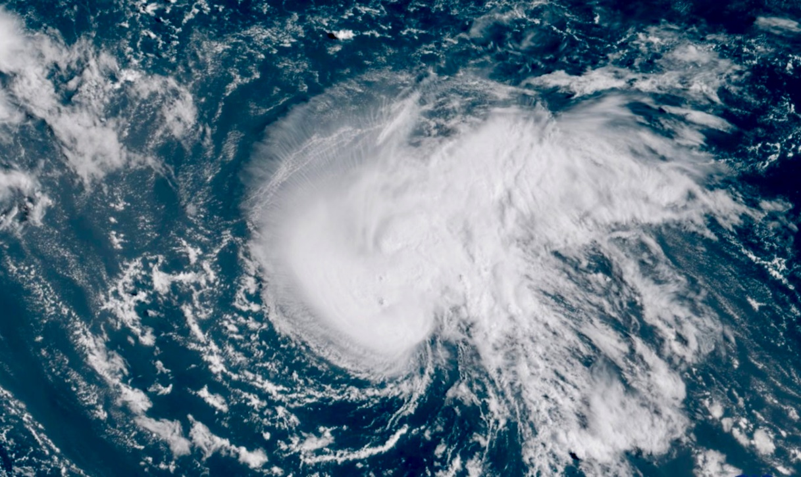
North Carolina
State Emergency Operations Center
Hurricane Florence
Thursday, 13 September 2018 – 0700

Slide 2
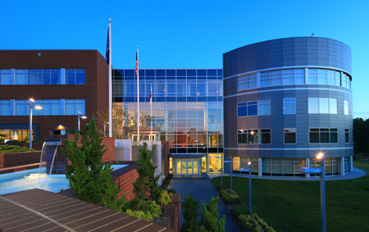
State EOC Schedule
Thursday, September 13, 2018
0700 | Shift Brief
1000 | Executive Summary Published
1130 | Lunch
1600 | Executive Summary & Situation Report Published
1600 | Operational Planning Meeting
1730 | Dinner
1900 | Shift Brief

Slide 3
Administrative Details
Event Name:
  20180907 Hurricane Florence
Reported Costs to Date: $6,325,008
Reminders:
  Document all costs in Finance Board
  Document all activities in Sig. Events Board
  Update ESF/Situation Report Board
  Check In/Out Room to Room

Slide 4
Incident Objectives
State EOC
Respond to resource requests and tasking within 30 minutes of assignment. Be prepared to support county response activities. Conduct an active public awareness campaign throughout the severe weather event. Develop a plan for post-event impact assessment and recovery activities. Monitor resource use and develop a demobilization plan for the release of resources as the situation allows.
RCC’s
Support local government preparation, response, and recovery efforts for the duration of the event. Mission priorities are life saving, rescue, evacuation, life sustaining power generation and transportation and traffic control. Review and validate assignment of mission requests received by RCC from the State EOC. Execute missions within prescribed timelines. Track all RCC resources and expenditures. Manage conference calls, produce branch tactical plan, situation reports and manage resources.
Emergency Services
Coordinate with SERT partners to mobilize life safety resources when requested throughout event. Maintain catalog of available state law enforcement mission packages to support local safety and security measures throughout the event.
Business EOC
Maintain situational awareness of state and private sector partner status and actions throughout the event. Process Re-Entry Certifications within 30 minutes throughout the event.

Slide 5
Incident Objectives
Communications
Efficiently manage statewide talkgroups for effective allocation in support of anticipated local, regional, and state level operations. Proactively evaluate primary and auxiliary operational communications needs based on forecasted weather, anticipated communication degradations, and anticipated surges in operations. Coordinate with SERT partners to quickly mobilize communication resources when requested throughout the event.
Risk Management
Develop and disseminate impact forecast and analysis products for impacted areas. Monitor and maintain WebEOC for resource requests.
Logistics
Respond to resource requests and tasking within 30 minutes of assignment. Provide equipment and commodities in support of impacted communities as quickly as possible. Coordinate travel, lodging and meals for State EOC staff as needed.
Infrastructure
Monitor and disseminate information to SERT partners and counties regarding power outages/disruptions/restorations and road closures throughout the event. Coordinate with Risk Management to evaluate impacts to structures and disseminate relevant information to SERT partners and county officials throughout the event.
Human Services
Execute plans for mass care and sheltering of evacuees, affected persons, pets and commercial animals.

Slide 6
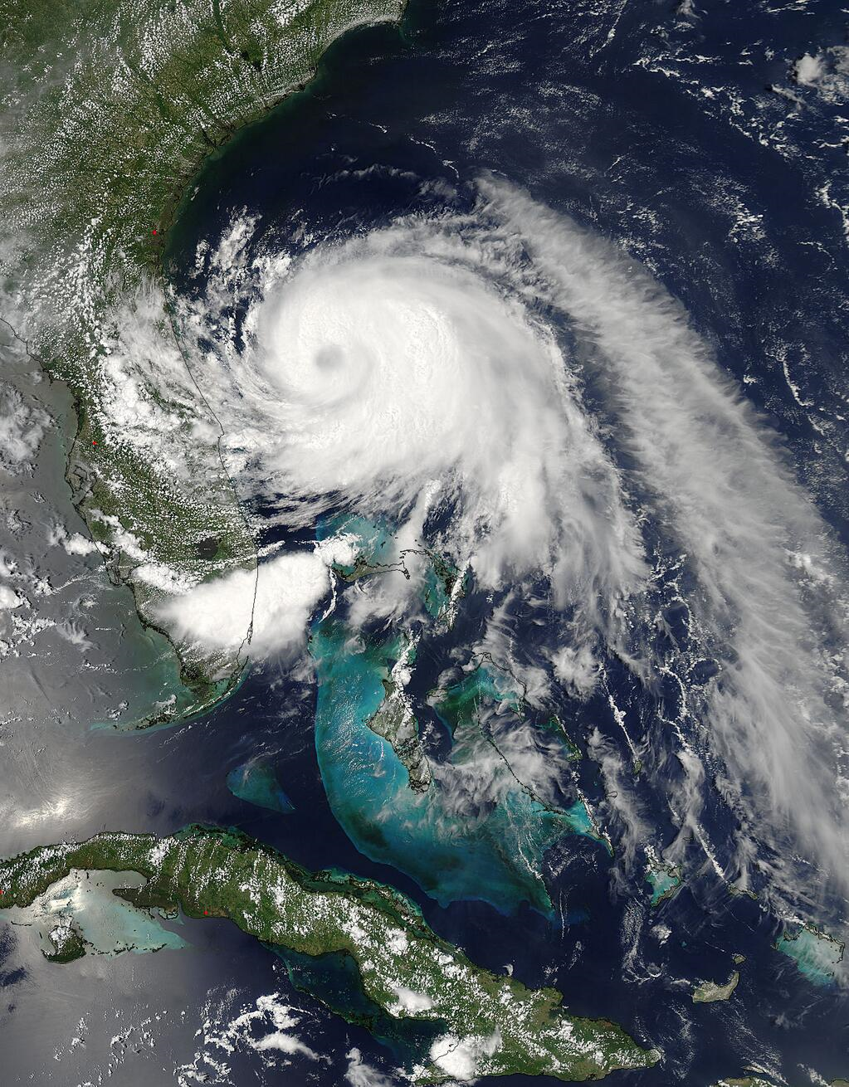
Weather

Slide 7
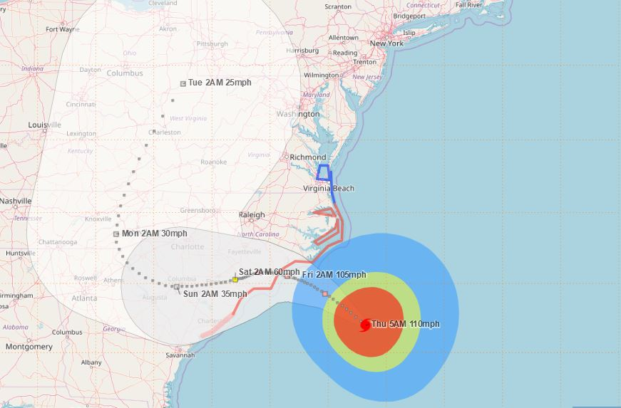


hurricane Florence
September 13, 2018 – 5AM
Hurricane Florence [5AM THU]
Location: Approx. 205 miles ESE of Wilmington, NC
Max Sustained Winds: 110 MPH
Movement: NW at 15 MPH
Min Central Pressure: 28.23” (956 mb)
The NHC Track Forecast Cone is NOT an Impact Cone
Significant impacts will be felt far from the center of the storm

Slide 8
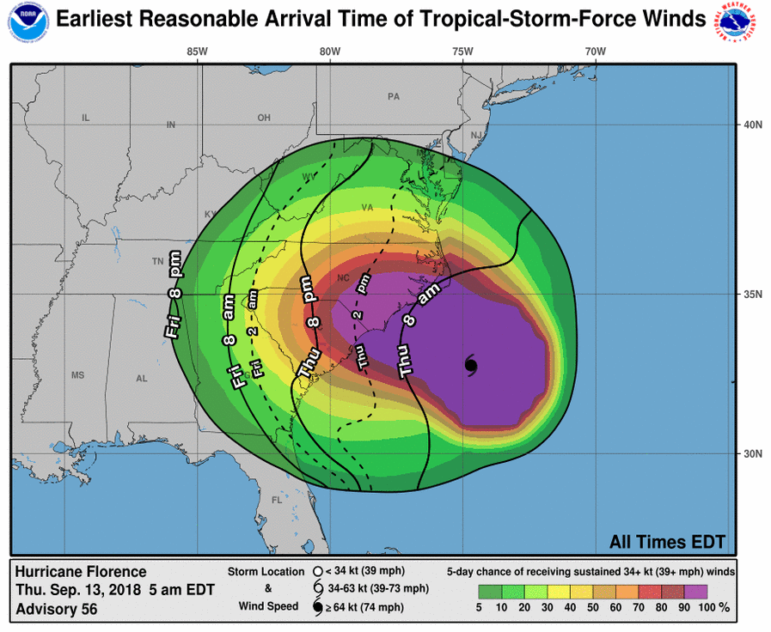
arrival of ts force winds
September 13, 2018 – 5AM

Slide 9
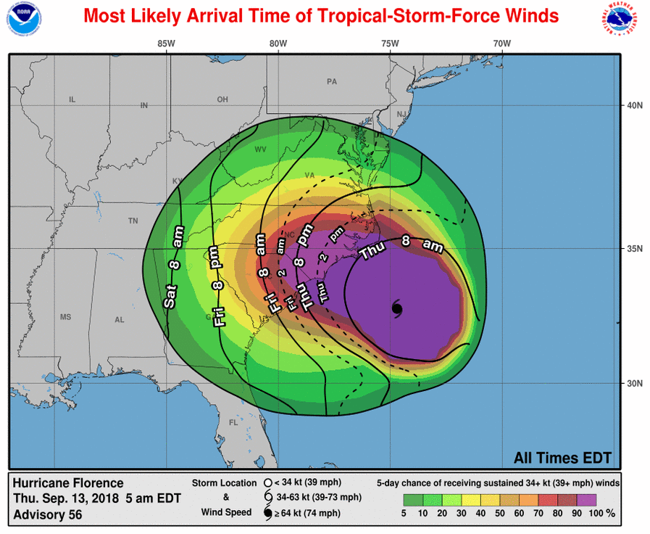
arrival of ts force winds
September 13, 2018 – 5AM

Slide 10
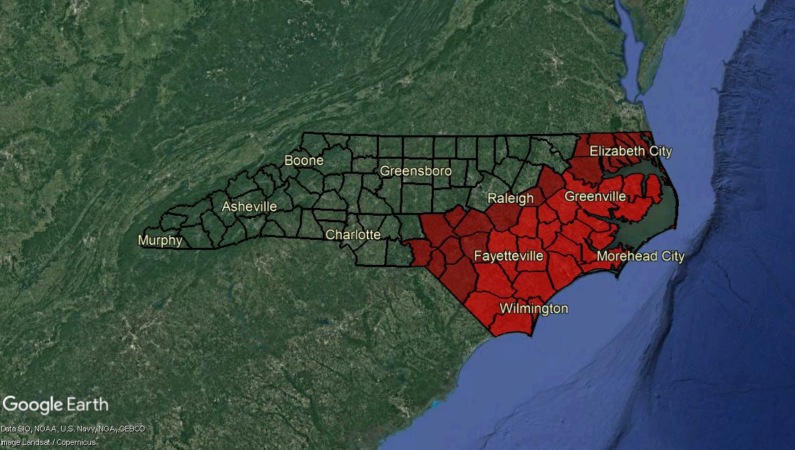

Current watches/warnings
September 13, 2018 – 5AM
Tropical Storm Warning
Tropical Storm Warning
Hurricane Warning

Slide 11
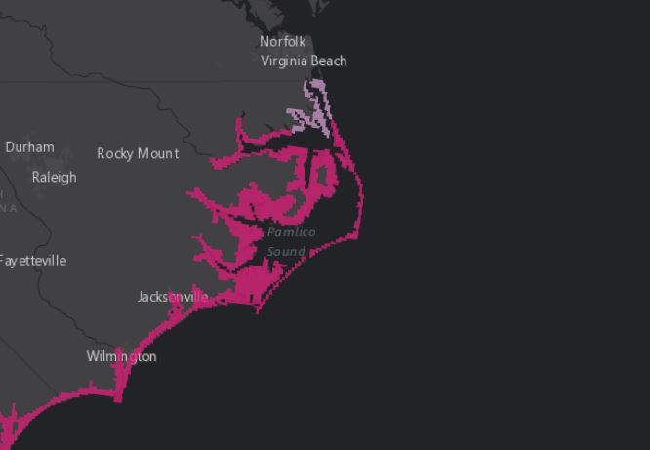
Storm surge warning/WATCH
September 13, 2018 – 5AM
Storm Surge
Watch
Potential Storm Surge Amounts:
6-9’ South of Cape Fear
9-13’ Cape Fear - Cape Lookout and along the Neuse, Pamlico,
Pungo, & Bay Rivers
6-9’ Cape Lookout - Ocracoke Inlet
4-6’ Ocracoke Inlet – Salvo
2-4’ North of Salvo
Storm Surge
Warning
A Storm Surge Warning means there is a danger of life-threatening inundation from rising water moving from the coastline during the next 36 hours in the indicated locations.
Storm surge is not just an ocean-front phenomenon. Surge impacts can occur away from the coast, especially along/near any tidally connected streams, creeks, rivers, waterways, and bays.

Slide 12
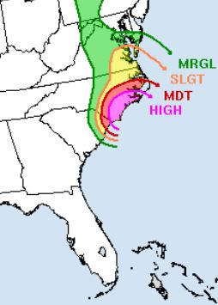
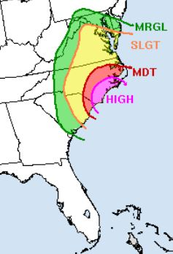
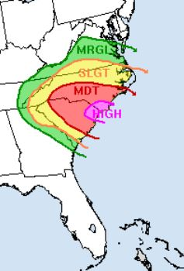

Flash flooding potential
September 13, 2018 – 5AM
NOAA/NWS/NCEP/WPC
High Risk Days are Rare, Dangerous, Significant, and Impactful
Thursday
Friday
Saturday

Slide 13
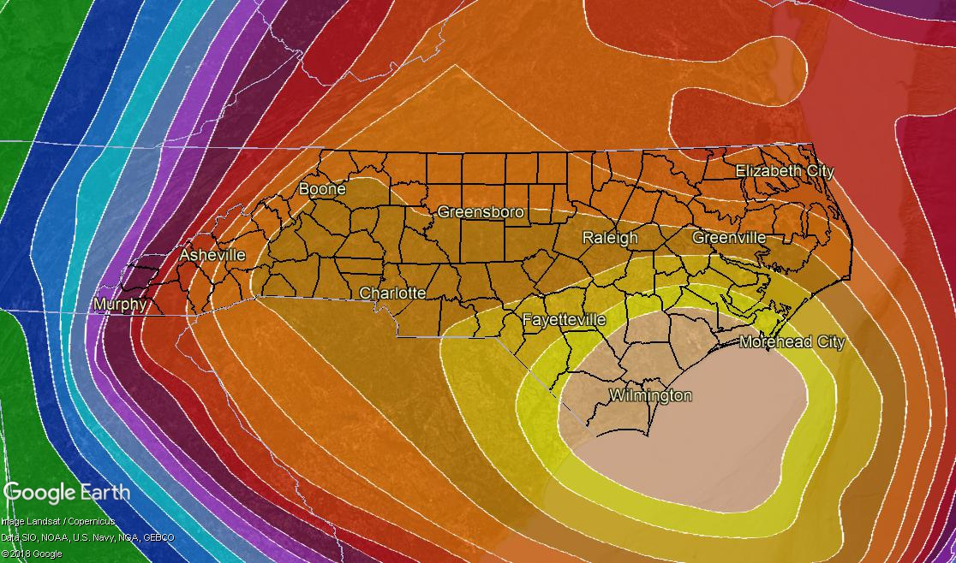
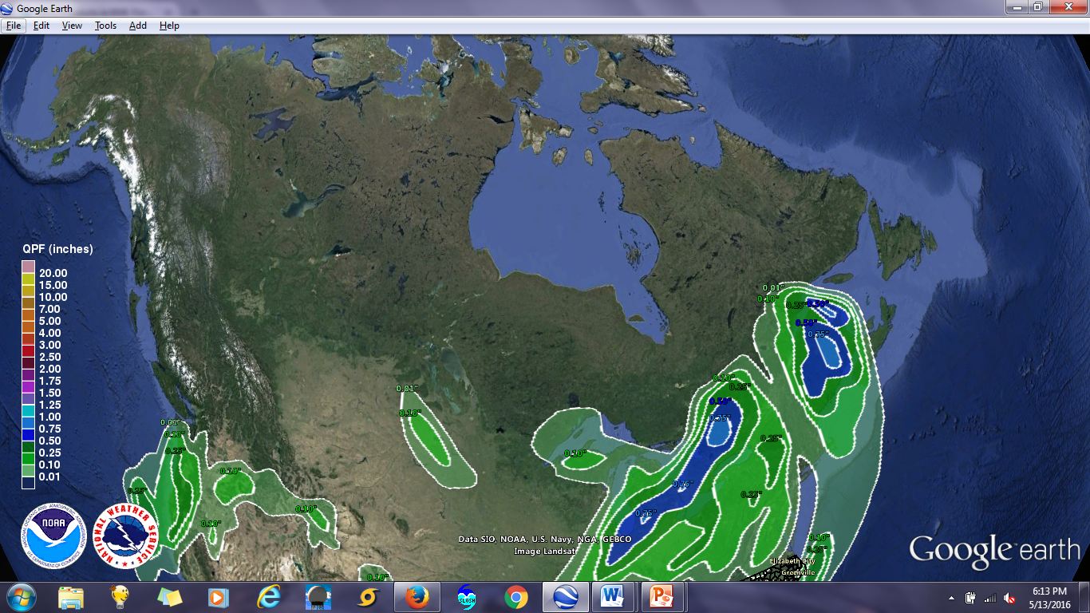
7-day rainfall forecast
8AM September 13, 2018 to 8AM September 20, 2018
4-5”
3-4”
5-7”
5-7”
7-10”
7-10”
15-20”
5-7”
10-15”
20-30”+
Rainfall amounts shown are averages, meaning locally higher amounts likely. Higher rainfall amounts will result in extreme flooding.
Heaviest rain across eastern NC expected Thursday – Saturday Night.
Heaviest rain across western NC expected Saturday – Monday Night.

Slide 14
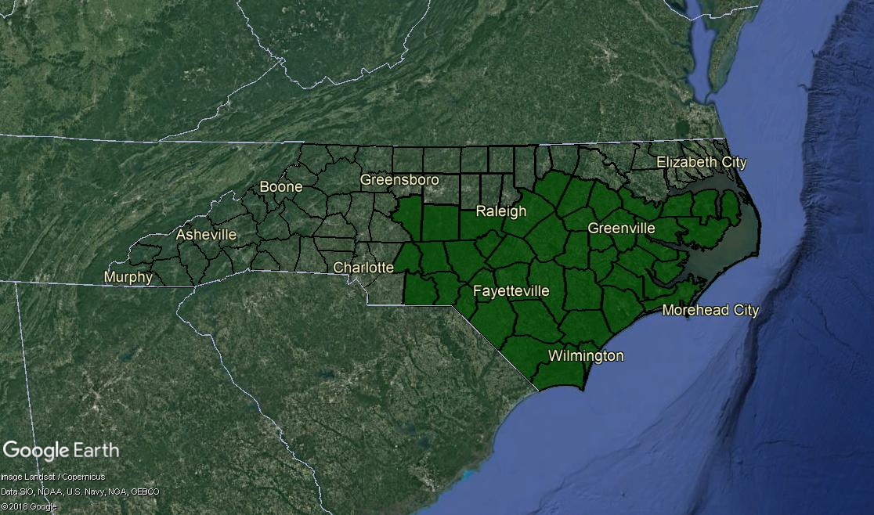
Flash flood watch
In Effect Until 8PM Saturday
*As of 5AM Thursday

Slide 15
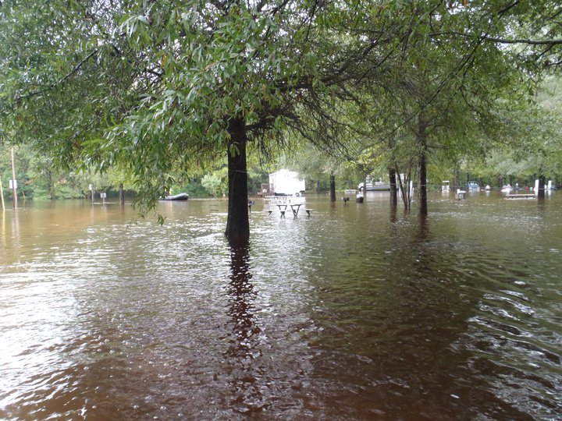
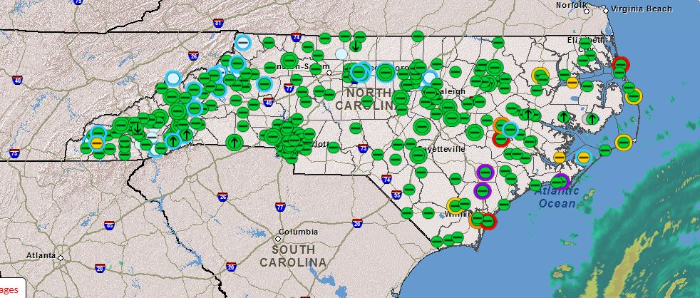
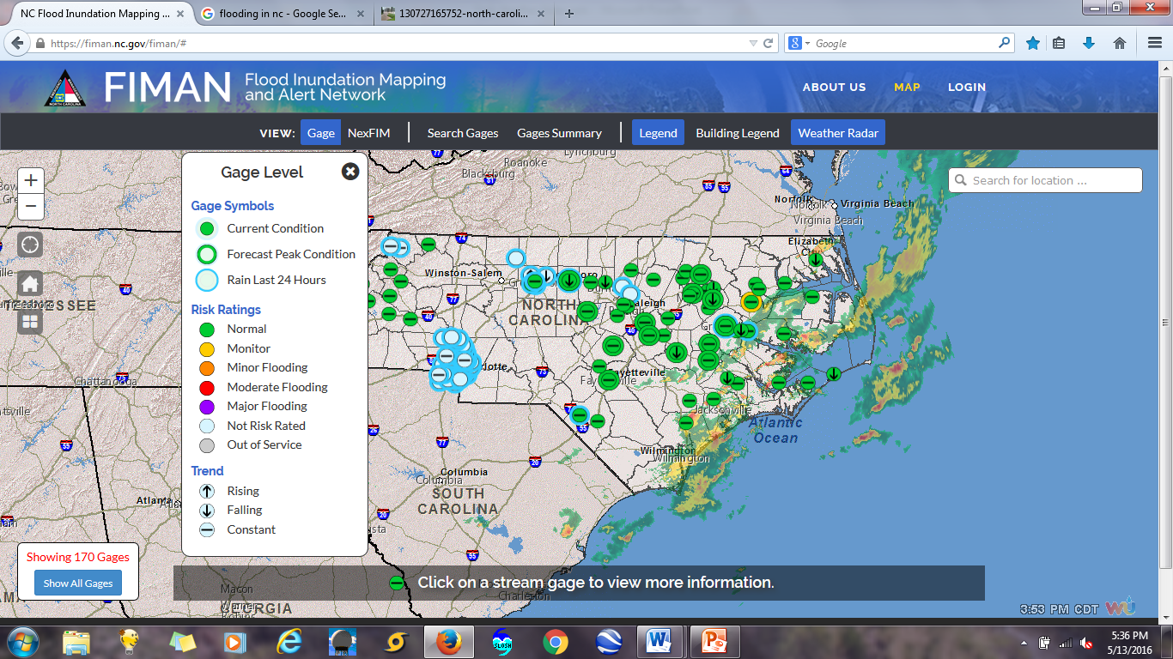
River Flood Outlook
September 13, 2018 – 5AM

Slide 16
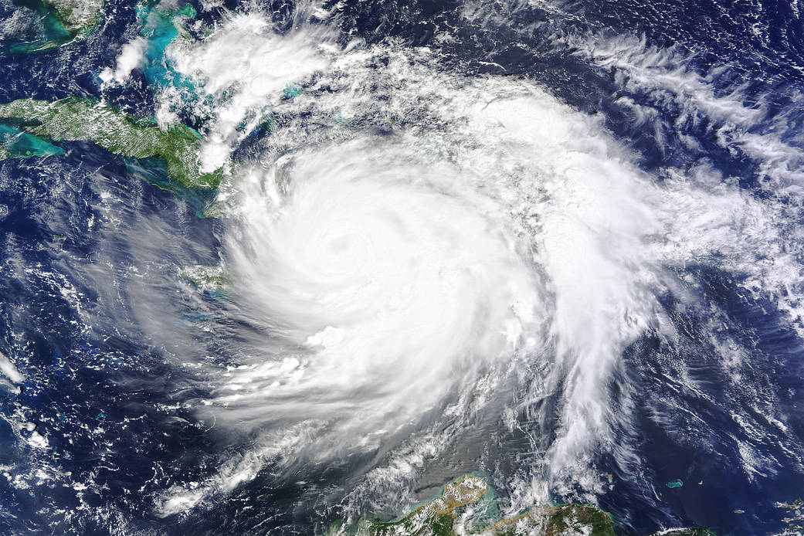
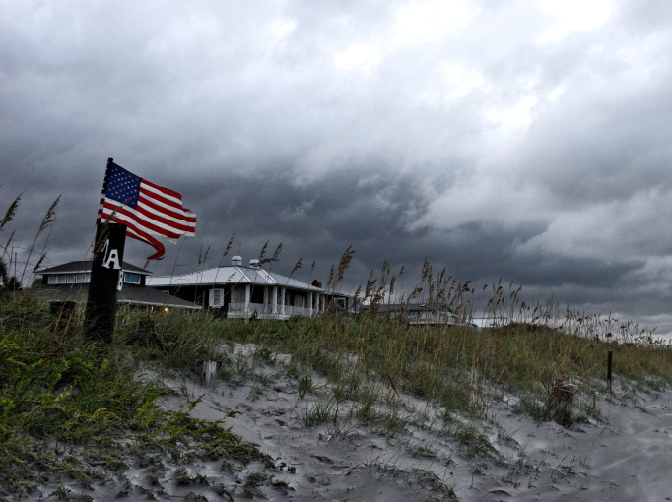
Hazards summary Hurricane Florence
September 13, 2018 – 5aM
HAZARD | DETAILS | IMPACTS | THREAT
Storm Surge | S of Cape Fear: 6-9’ Cape Fear-Cape Lookout: 9-13’ (Neuse, Pamlico, Bay, Pungo Rivers) Cape Lookout-Ocracoke Inlet: 6-9’ Ocracoke Inlet-Salvo: 4-6’ N of Salvo: 2-4’ | Very dangerous inundation amounts are expected along the NC coast Thu-Sat. | Extreme
Inland Flooding | Coastal NC: 20-30” (Isolated 40”) Central, Western, NE NC: 6-12” (Isolated 24”) | Sig. threat to life and property; impassable roads; road wash-outs. Heaviest rain across E NC Thurs – Sat night and across W NC Sat –Mon night. Longer-term river flooding likely, and mountain landslides possible. | Extreme
Damaging Winds | Hurricane-Force winds are likely near the coast Tropical Storm-Force winds possible across much of state | Significant downed trees and widespread/prolonged power outages across the state; significant structure damage possible as Florence near the coast | Extreme
Tornadoes | A few tornadoes are possible Thu and Fri, across eastern NC. Tornadoes in tropical systems are typically short-lived and weak, but offer very little lead time. |  | Moderate
Marine & Coastal | Life-threatening surf and rip currents will continue for much of the week. |  | Extreme
Threat Levels: | None | Low | Moderate | High | Extreme

Slide 17
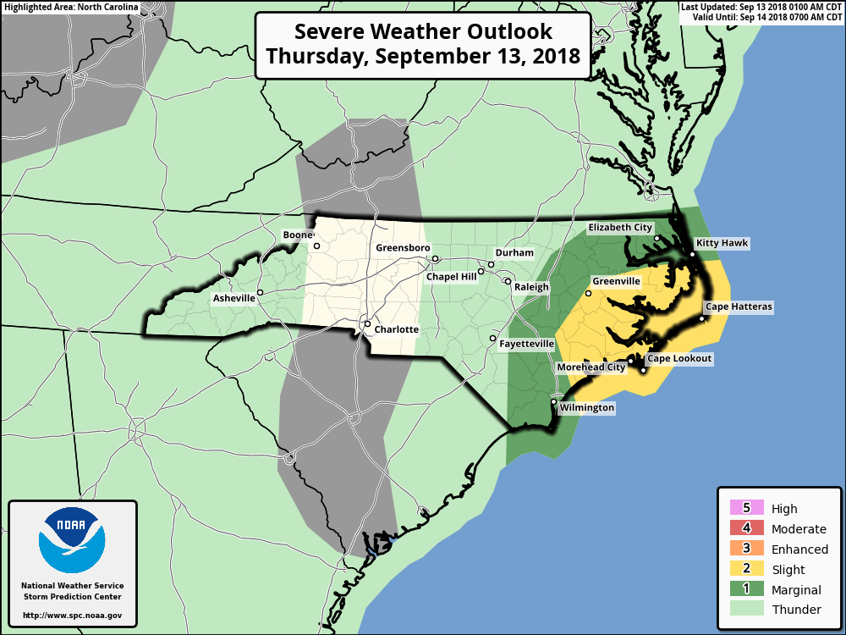
THURSDAY’s severe storm threat
Storm prediction center (Valid 8am 9/13/18 – 8am 9/14/18)
A few tornadoes are possible Thursday and Thursday night across portions of Eastern NC.
Tornadoes in tropical systems are typically weak and short-lived, but often do not offer much warning time.

Slide 18
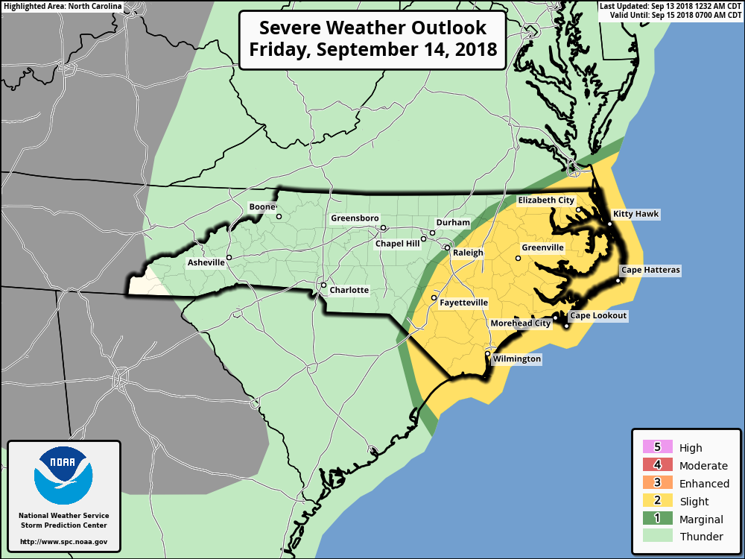
friDAY’s severe storm threat
Storm prediction center (Valid 8am 9/14/18 – 8am 9/15/18)
Tornado potential extends into Friday and expands westward.
Tornadoes in tropical systems are typically weak and short-lived, but often do not offer much warning time.

Slide 19
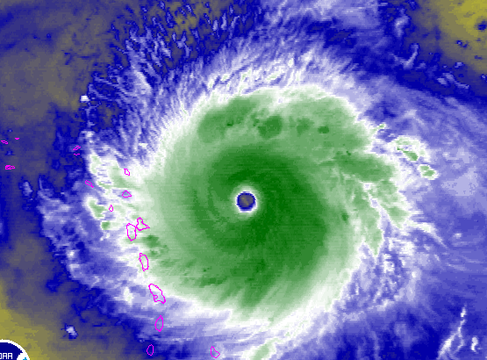

HURRICANE FLORENCE
September 13, 2018 – 5AM
Key Takeaways:
Life-Threatening Impacts Will Extend Far From The Storm’s Center: The forecast is very similar to previous updates as widespread & extreme impacts from heavy rain, storm surge, and wind are still expected.
Rain:
  Coastal NC: 20-30”; isolated totals to 40”
  Remainder of NC: 6-12”; isolated totals to 24”
Storm Surge:
  Cape Fear – Cape Lookout (Pamlico, Neuse, Pungo, Bay Rivers): 9-13’
  South of Cape Fear and Cape Lookout – Ocracoke Inlet: 6-9’
  Ocracoke Inlet - Salvo: 4-6’
  North of Salvo: 2-4’
Wind:
  Hurricane-force winds are expected across portions of Coastal NC
  Tropical Storm-force winds are possible across much of the state

Slide 20
Situation Report

Slide 21
County Impacts
State of Emergency (64 of 100 counties):
- 32 in Eastern Branch
- 27 in Central Branch
- 5 in Western Branch
School Closings: 56 Districts closed, 2 have an early release.

Slide 22
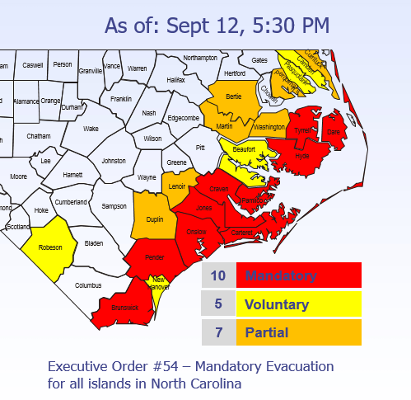
Evacuations

Slide 23
Shelters
Shelters opened or opening today: 108
Pet Friendly: 29
Clients: 6,962 Capacity: 34,717

Slide 24
Overall SERT Response
Location/Resource | Status | Level
State EOC | Activated | 1
Business EOC | Activated | Y
Recovery EOC | Activated | Y
Joint Information Center | Activated | Y
RCC East | Activated | Y
RCC Central | Activated | Y
RCC West | Activated | Y
EMAC | Activated | Y
Federal | Activated
FEMA IMAT | Y
FEMA Liaison Officer | Y
FEMA Incident Support Base | Y
FCO | Y
Federal Declaration
9/10/2018 – FEMA-3401-EM
Date | Executive Orders
9/7/2018 | #51 - State of Emergency Declaration
9/7/2018 | #52 - Temporary Suspension of Motor Vehicle Regulations
9/10/2018 | #53 – Fuel Transportation Waiver
9/11/2018 | #54 – Mandatory Evacuation for Coastal Islands

Slide 25
Around the Room
Operations
Logistics
Recovery
Risk Management
Resiliency
Administration/Finance
Joint Information Center
Business EOC
FEMA

Slide 26
SERT Leader Guidance
Respond to Resource Requests w/in 30 Minutes
Share Information
Let Us Know if you See a Gap in the Response
Have Faith in the Team!

Slide 27
North Carolina
State Emergency Operations Center
Hurricane Florence
Thursday, 13 September 2018 – 0700

